Slide 1
Java Tutorial 2
Programming Style && JavaDoc && Output Format && String Concatenation

Slide 2
Topics
Programming style
JavaDoc
Output Format && string concatenation
Assignment 1
Notes:
There are four topics in today’s tutorial. The first one is Programming style,

Slide 3
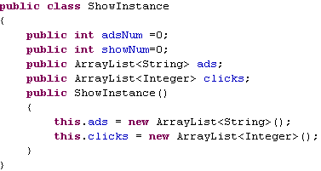
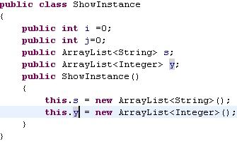
Motivation of programming style
Who will read the Java code? Computers? Or Developers?
Not only computers, but more importantly, the developers!
Good code is easy to understand by human.
Good examples: adsNum, showNum
Bad examples: i, j, s, y
Notes:
In the beginning, let’s think about a question. Who will read the Java codes? Computers ? Or developers? The answer is obvious, computers and developers. But more importantly, developers!
The developers of your codes contain not only yourself, but also your partners and your potential followers.
We all know that Java code is compiled into byte code and byte code is translated into machine code for computers to execute. With the help of compilers and JVMs, computers can read the java code correctly and efficiently. However, for developers, things are different. It’s much slower to use our brain to understand the logic behind the code. You may become totally confused by your own code written a month earlier by yourself. And you may get crazy by someone else’s ugly codes. For example, i,j, s,y in this program fragment, they are meaningless variables. You have to read a lot of code to understand what role it plays in the code. But for these variables, they have meaningful names. adsNum means the number of advertisement and showNum means the number of TV shows. Well-defined variable names can save us a lot of time to understand the code. It’s a matter of programming style.

Slide 4
What is programming style?
Programming style is a set of rules or guidelines used when writing the source code for a computer program.
Naming Conventions
Comments
Indentation
etc.
Notes:
There are many aspects in programming style like naming conventions, comments, indentation and so on. In my point of view, naming conventions and comments are the most important.

Slide 5
General naming conventions
Names representing classes must be nouns and written in mixed case starting with upper case.
public class Hello
public class HelloWorld
Variable names must be in mixed case starting with lower case.
int iterationCounter
Names representing constants (final members) must be all uppercase using underscore to separate words.
MAX_ITERATIONS
Names representing methods must be verbs and written in mixed case starting with lower case.
getLength()
Abbreviations and acronyms should not be uppercase when used as name.
exportHtmlSource()
Notes:
There are many practical good conventions proposed by our predecessors. These are the most classic guidelines listed on this page.

Slide 6
Comment your code
JavaDoc /** ----- */
Block comments /* ----- */
Single-line comments //
Notes:
A comment is a readable annotation in the source codes.
The comments can make the source codes easier to understand for developers.
Comments are generally ignored by compilers and interpreters.
In another words, compilers cannot see the comments, the comments can only be observed by human, by developers.

Slide 7

Comment your code
Single-Line Comment
Block Comment
Notes:
This is an example.
The green words are comments.

Slide 8
Javadoc
Javadoc is a documentation generator from Oracle Corporation for generating API documentation in HTML format from Java source code.
Format: /** ----- */
Tags:
Tag & Parameter | Usage | Applies to
@author John Smith | Describes an author. | Class, Interface, Enum
@version version | Provides software version entry. Max one per Class or Interface. | Class, Interface, Enum
@since since-text | Describes when this functionality has first existed. | Class, Interface, Enum, Field, Method
@see reference | Provides a link to other element of documentation. | Class, Interface, Enum, Field, Method
@param name description | Describes a method parameter. | Method
@return description | Describes the return value. | Method
@exceptionclassname description @throwsclassname description | Describes an exception that may be thrown from this method. | Method

Slide 9
Javadoc
This is a typical class example:
// some import statements
/**
* @author Firstname Lastname <address @ example.com>
* @version 1.6 (current version number of this program)
* @since 2020-09-10 (the time when this class was first created)
*/
public class Test {
// class body
}
Notes:
The version number is very important, because in practical developing, you have to improve your software many times. You have to keep your version numbers to facilitate software management.

Slide 10
Javadoc
This is a typical method example:
/**
* Short one line description.
* <p>
* Longer description. If there were any, it would be
* here.
* <p>
* And even more &lt;explanations&gt; to follow in consecutive
* paragraphs separated by HTML paragraph breaks.
*
* @param x Parameter description text.
* @param y Parameter description text.
* @return Return int value description text.
*/
public int methodName ( int x, double y )
{
// method body with a return statement
}
Notes:
Angle brackets
p tag in html

Slide 11
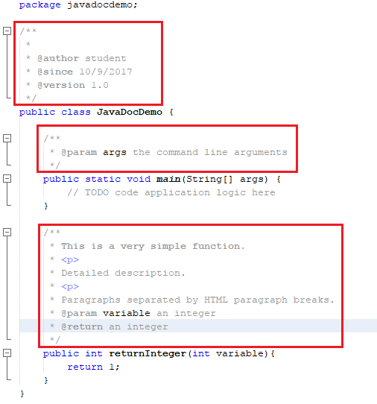
Javadoc

Slide 12
Generating Javadoc
To generate Javadoc in NetBeans:
Menu Run → Generate Javadoc

Slide 13
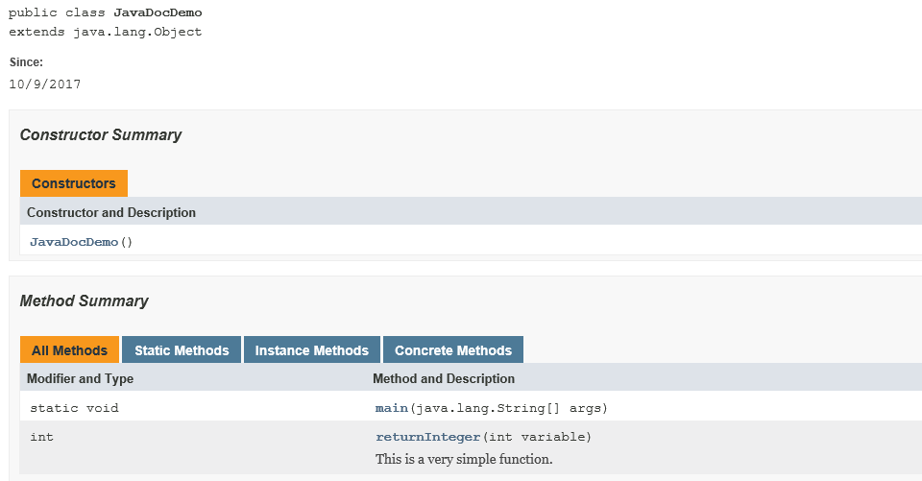
Javadoc

Slide 14
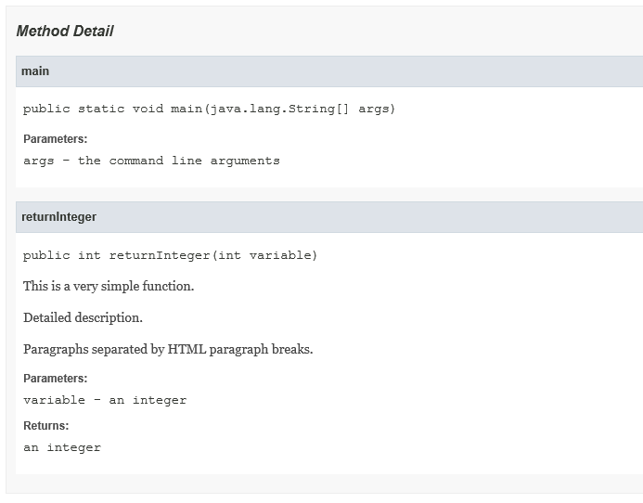
Javadoc

Slide 15
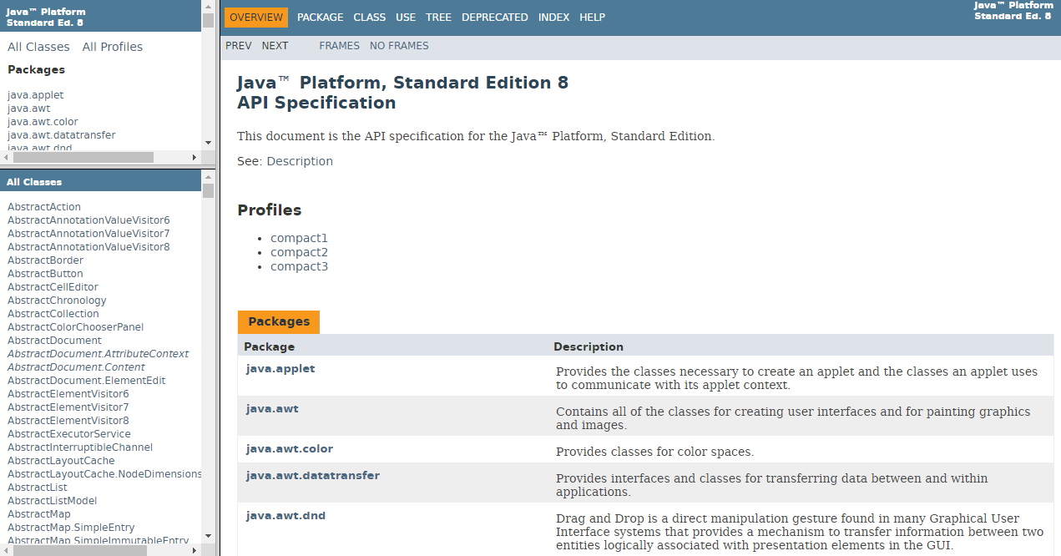
Java documents: extraction of comments in existing classes
http://docs.oracle.com/javase/8/docs/api/
Almost everything you need can be found here.

Slide 16
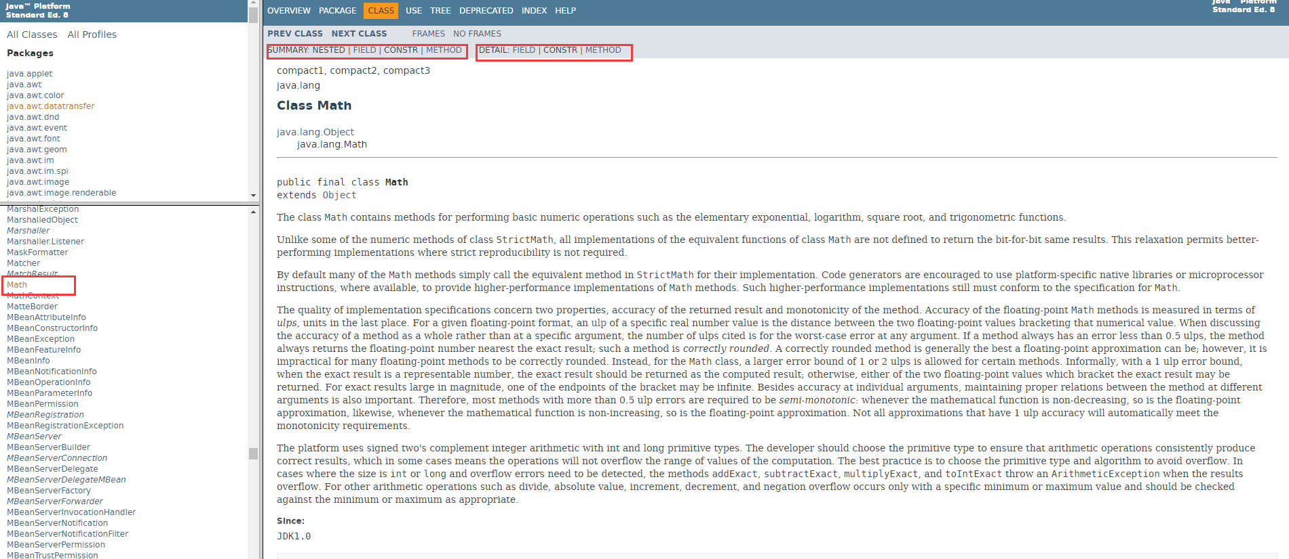
Java API Documentations
Surfing the documentation, e.g., Math class

Slide 17
System.out.print()
String s = "Hello!";
int i = 1234;
JFrame f = new JFrame();
System.out.print(i);
System.out.print(s);
System.out.print(f);
Output: 1234
Output: Hello!
javax.swing.JFrame[frame0,0,0,0x0,invalid,hidden,layout=java.awt.BorderLayout,title=,resizable,normal,defaultCloseOperation=HIDE_ON_CLOSE,rootPane=javax.swing.JRootPane[,0,0,0x0,invalid,layout=javax.swing.JRootPane$RootLayout,alignmentX=0.0,alignmentY=0.0,border=,flags=16777673,maximumSize=,minimumSize=,preferredSize=],rootPaneCheckingEnabled=true]
Notes:
This is the inner state of a Jframe object. Don’t care these details.

Slide 18
System.out.printf()
You can format your output by specifying the format specifier.
String s = "Hello!";
int i = 1234;
// "%" means formatted output.
System.out.printf("%d", i);
// "d" means Decimal integer
System.out.printf("%o", i);
// "o" means Octal integer
System.out.printf("%x", i);
// "x" means Hexadecimal integer
System.out.printf("%s", s);
// "s" means string
Output: 1234
Output: 2322
Output: 4d2
Output: Hello!

Slide 19
System.out.printf()
double d = 345.678;
System.out.printf("%f\n", d);
// "\n" means newline
// "f" means floating-point number
System.out.printf("%9.2f\n", d);
// "9" means field width
// ".2" means the number of decimal places
System.out.printf("%09.2f\n", d);
// "0" means zero-padding
System.out.printf("%+9.2f\n", d);
// "+" means output with sign
System.out.printf("%-9.2f\n", d);
// "-" means left-alignment
Output: 345.678000
Output: 345.68
Output: 000345.68
Output: +345.68
Output: 345.68

Slide 20
System.out.println()
Similar to print(), except that it will terminate the current line by writing the line separator string. Following outputs will start in a new line.
String hello = "Hello!";
String good = "Good afternoon!";
System.out.println(hello);
System.out.println(good);
System.out.print(hello + "\n");
System.out.print(good + "\n");
System.out.print(hello);
System.out.print(good);
Output: Hello!
Good afternoon!
Output: Hello!Good afternoon!

Slide 21
String concatenation
Two ways:
public String concat(String str), e.g.,
String a = "He";
String b = "llo";
String c = a.concat(b);
2. Use "+"
String c = a + b;
System.out.print(c);
will show:
Hello

Slide 22
Assignment 1

Slide 23
Aims
Get acquaint with the NetBeans Java programming environment
Learn the structure and format of a Java program by example
Let you make mistakes and learn from such!

Slide 24
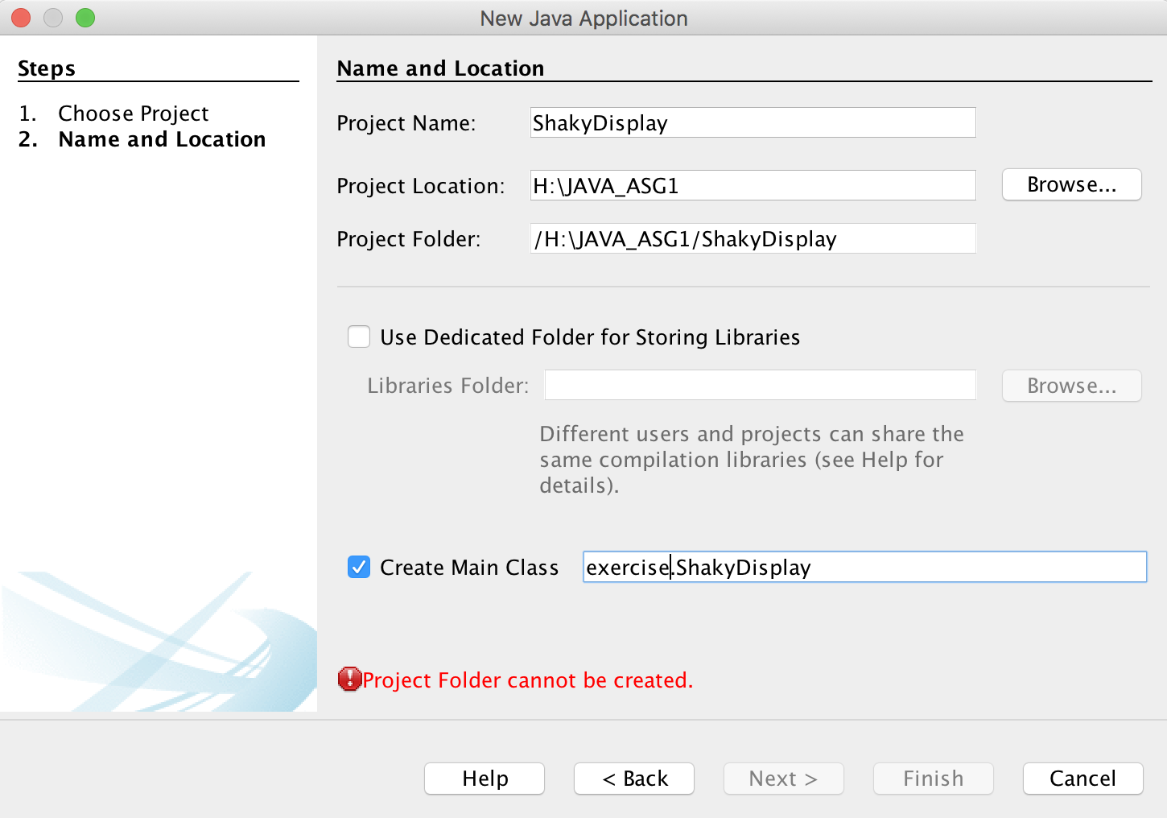
Procedure
Remember the location of your project

Slide 25
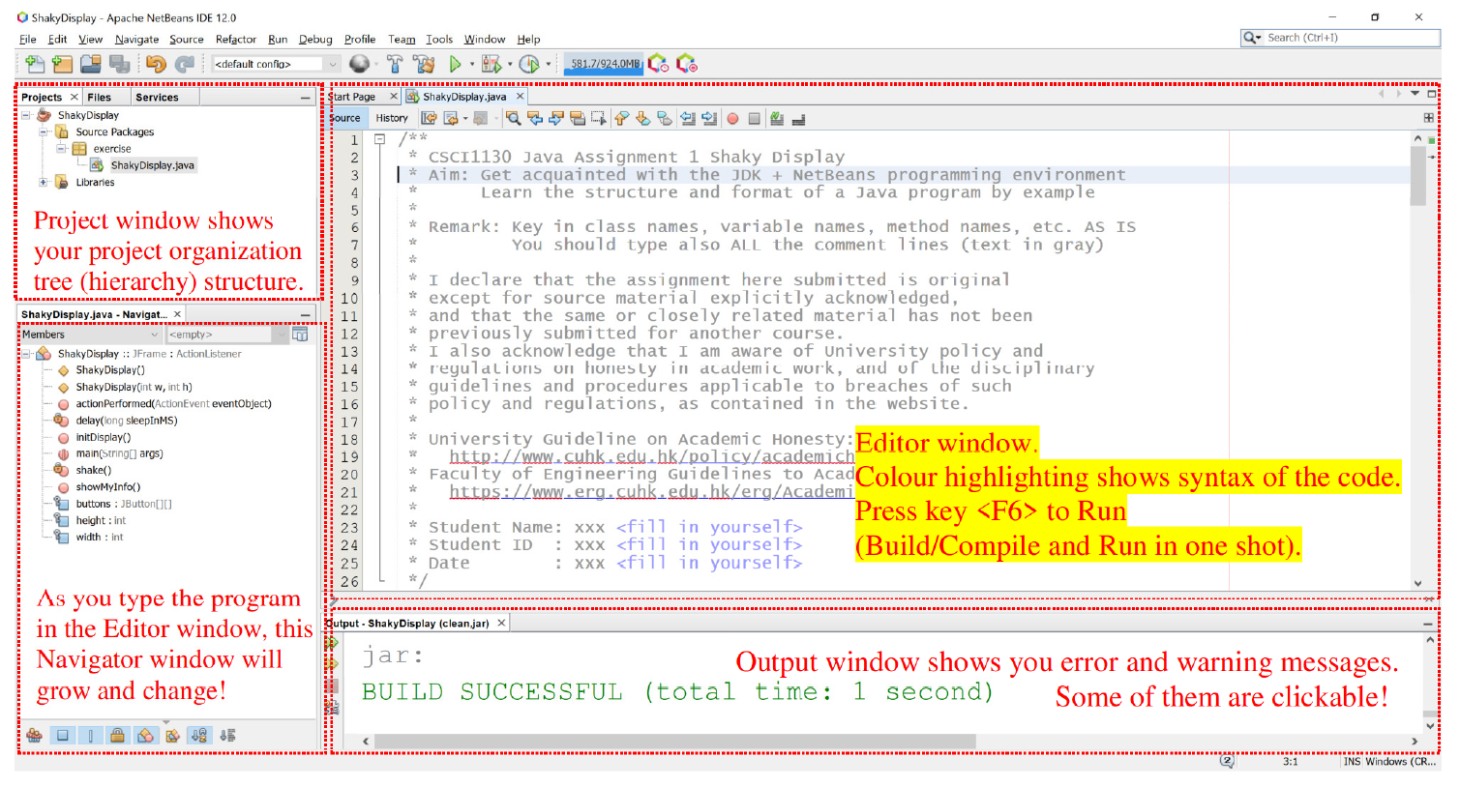
Procedure

Slide 26
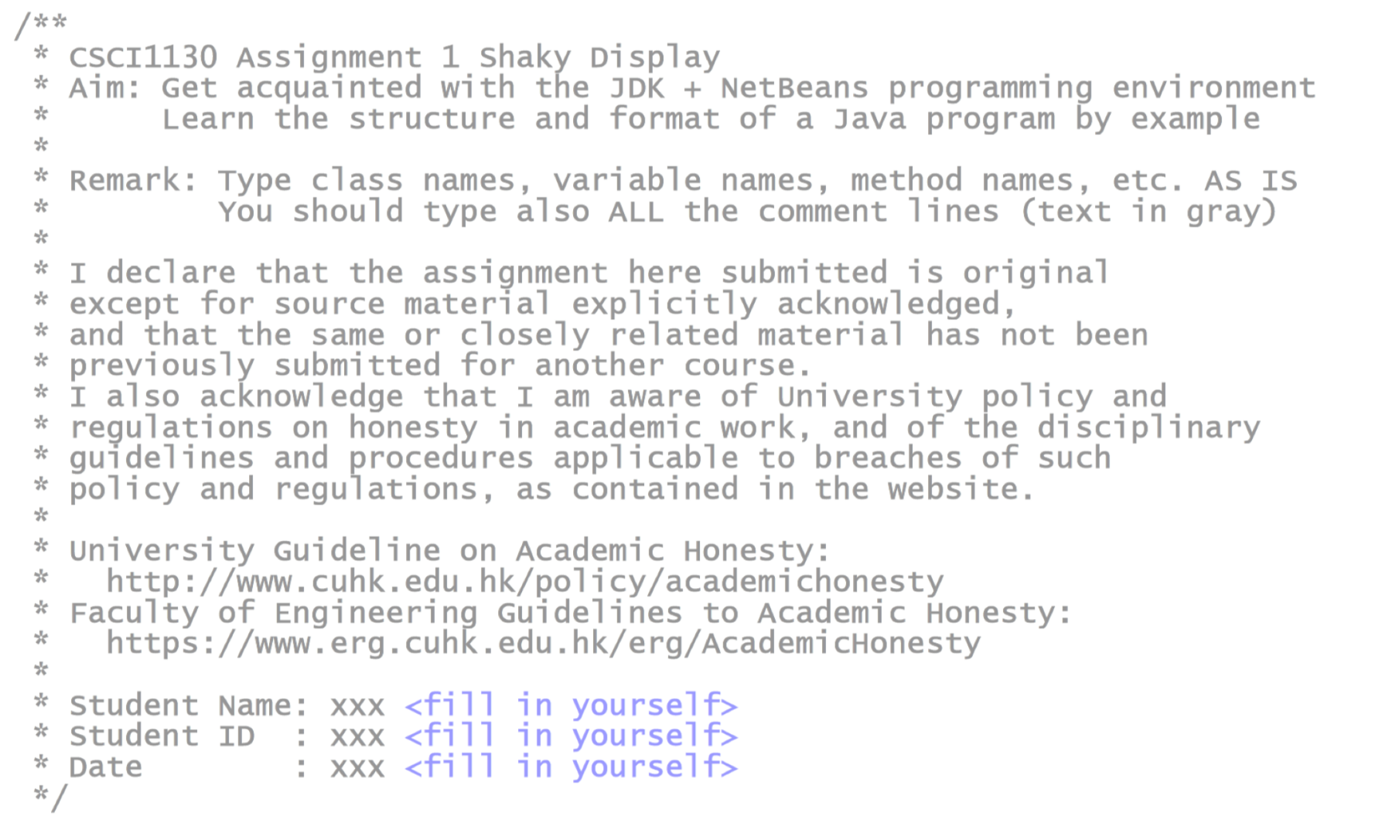
Procedure
NOTE: Fill in your own student ID, name and date here!

Slide 27
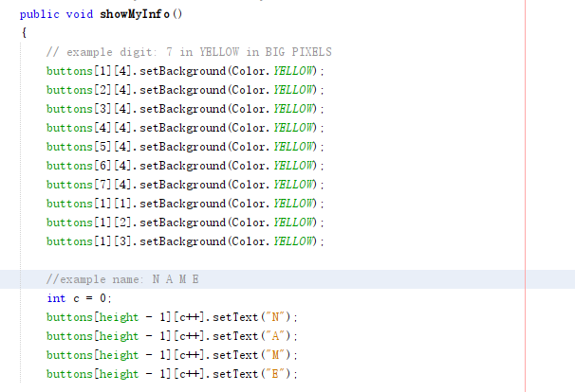
Your Task
Customize method showMyInfo()

Slide 28
Run Application
Run the application (press the function key [F6] on the keyboard). Enjoy your work.
Try clicking some buttons a few times and observe the effects.
You may vary the number of buttons shown to fit your surname; see method main().
You may design the letter style and the size of each digit/ character of your own.
As a beginner, we do NOT expect you understanding the whole given program. However, you shall be able to figure out the coordinates system and "paint" your project creation time in HH:MM using button "blocks" and show your surname by following our example statements in the given example method showMyInfo().

Slide 29
Submit Your Assignment
1. Locate your NetBeans project folder, e.g. H:\JAVA_ASG1\ShakyDisplay\
2. ZIP the project folder ShakyDisplay and Submit the file ShakyDisplay.zip via our Online Assignment Collection Box on Blackboard <https://blackboard.cuhk.edu.hk>

Slide 30
Marking Scheme and Notes
1. The submitted program should be free of any typing mistakes, compilation errors and warnings.
2. Comment/remark, indentation, style are under assessment in every programming assignments unless specified otherwise. This program gives you an example of a well-formatted source file. Variable naming, proper indentation for code blocks and adequate comments are important.
3. Remember to do your submission before 6:00 p.m. of the due date. No late submission would be accepted.
4. If you submit multiple times, ONLY the content and time-stamp of the latest one would be counted. You may delete (i.e. take back) your attached file and re-submit. We ONLY take into account the last submission.

Slide 31
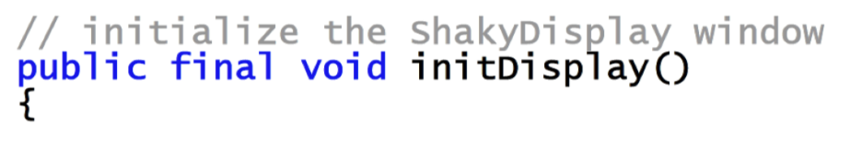
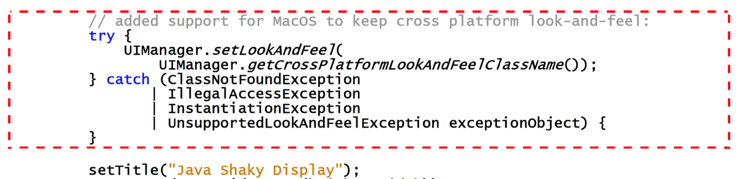

Appendix: Demystify try-catch block - Adding Support for MacOS
…

